Slide 1

Sudan University Of Sciences & Technology
College Of Oil & Mining Engineering
Petroleum Engineering Department
بسم الله الرحمن الرحيم
Calculations of Oil Reserve -
Bentiu Formation In Jake Oil Field,
Using Volumetric Method
حساب الإحتياطي النفطي لتكوين بانتيو في حقل جيك النفطي بإستخدام الطريقة الحجمية
Presenters :
Ahmed Abdelrahim Gafar Elkhalifa Elhassan
Elmugdad Mohamed Abelrahman Elbalola
Moumen Abalrahman Hassan
Noor ali Mahmoud hamid
Supervisor : Dr. Adel Abdul Magid Saad

Slide 2

Introduction
Problem statement
Outlines
Objectives of project
Literature review
Methodology
Results and discussion
Conclusion & recommendations
References

Slide 3
Introduction
Objectives
Methodology
Conclusion
P.statement
L.review
Results
References
Reserve Calculation
methods
Introduction
Geo.Method
Eng.Method
Analogy
Dicline Curve Analysis
Volumetric
Reservoir Simulation
Matiriralblunce

Slide 4

Problem Statement
Introduction
Objectives
Methodology
Conclusion
P.statement
L.review
Results
References
Calculate the volume of hydrocarbons present in Jake oil field

Slide 5

Objectives
Introductio
Objectives
Methodology
Conclusion
P.statement
L.review
Results
References
Is to calculate the latent and recoverable oil reserves in “Jake oil field“ And that is for its economic importance to the country.

Slide 6
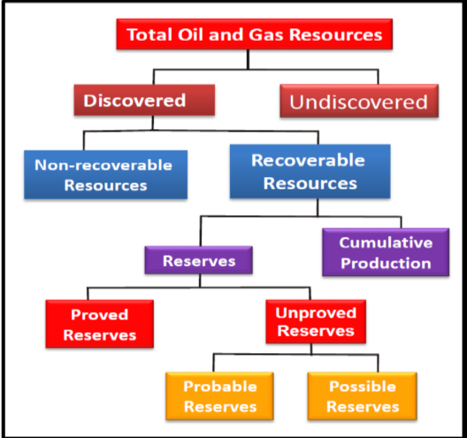
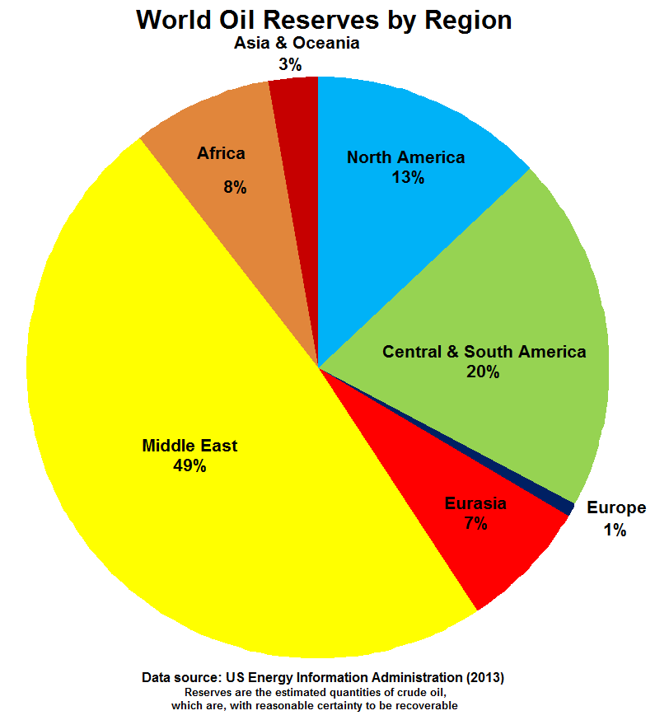
Introduction
Objectives
Methodology
Conclusion
P.statement
L.review
Results
References

Slide 7
Introduction
Objectives
Methodology
Conclusion
P.statement
L.review
Results
References
tax purposes
purposes of gas sales
financing purposes
PURPOSE OF RESERVES ESTIMATION
corporate purposes
purposes of unitization or joint operations division of ownership
purposes of purchase or sale of companies or properties
budget purposes

Slide 8
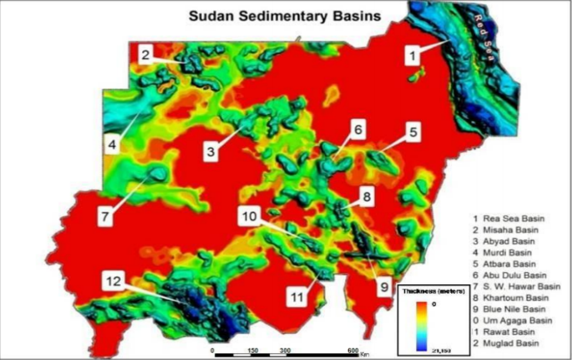

Slide 9
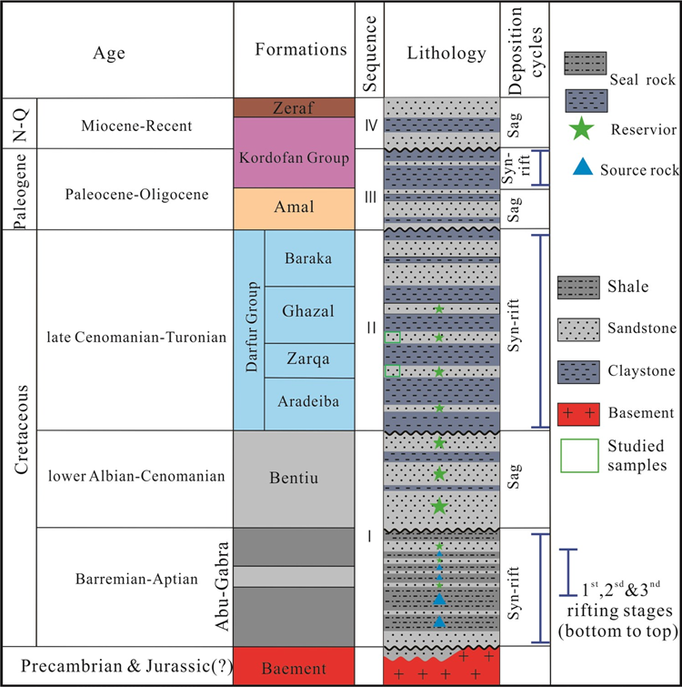
The main stratigraphic column of the Northeastern region of the Methodology.

Slide 10
Introduction
Objectives
Methodology
Conclusion
P.statement
L.review
Results
References
For the Reservoir identification the most useful indicator was obtained from the behavior of the gamma ray, density, and neutron logs.
The pay zone in the well (Jake South-8) was determined, its equal 26.2 ft
The water oil contact in the depth 1503 m.
The reservoir area has been calculated using (ArcMap 10.4.1) version, and found it is equal 10 acres.
The evaluation of the wells data has been processed using the interactive petrophysic software (IP 3.5) version.
Porosity are calculated by using IP software and neutron-density combination.
Water saturation are calculated by using IP software and archie's equation.
The latent and recoverable oil reserve existing in reservoir are calculated by using volumetric method.

Slide 11



Rock properties
Absolute porosity:
POROSITY
Effective porosity:

Slide 12
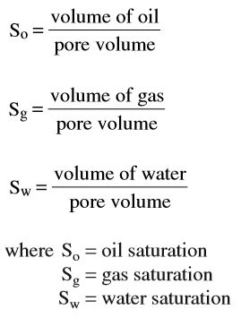


Rock properties
SATURATION

Slide 13
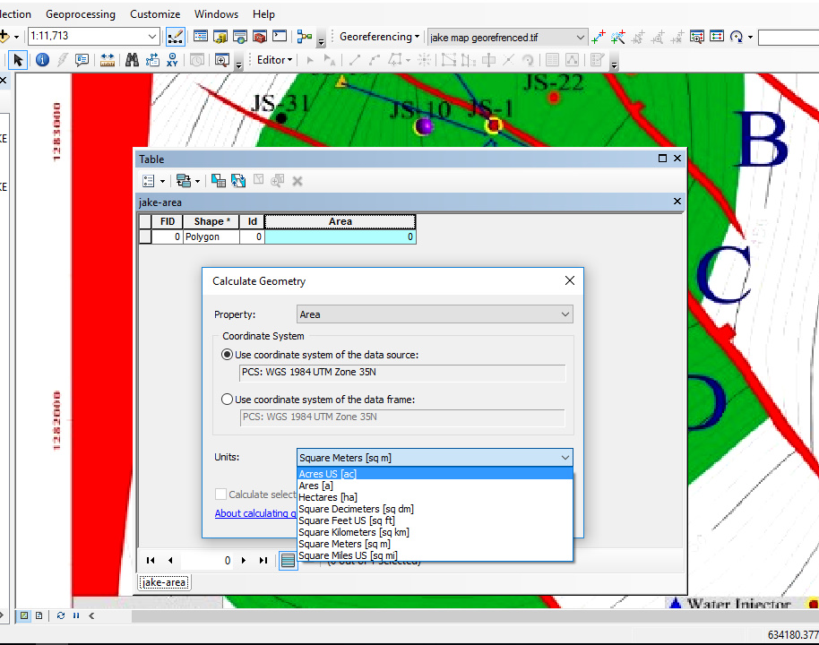
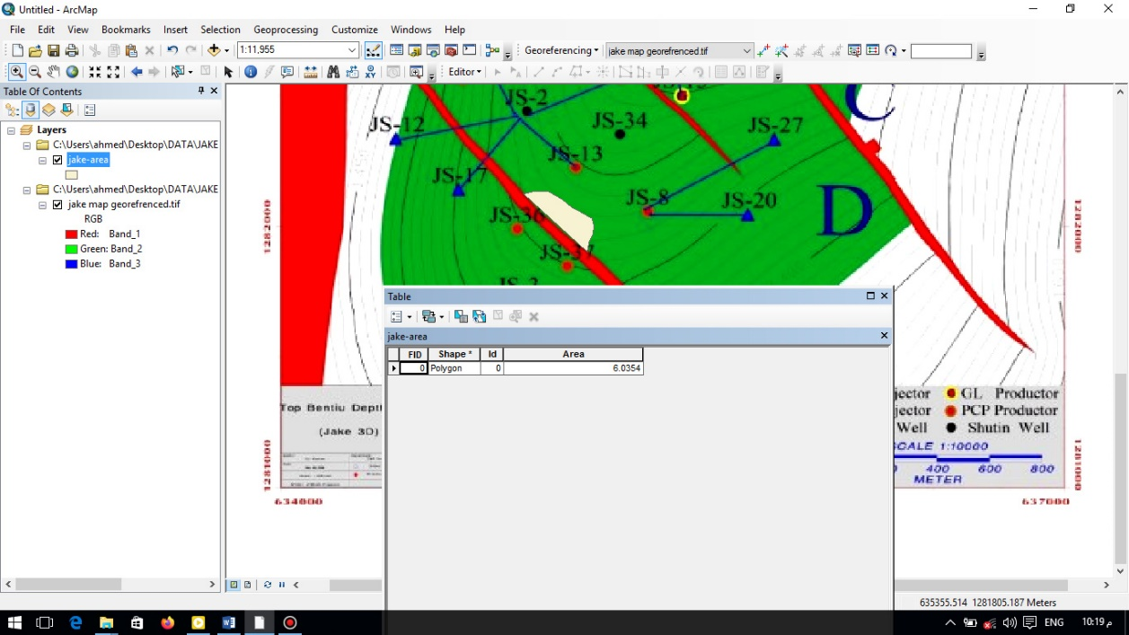
Introduction
Objectives
Methodology
Conclusion
P.statement
L.review
Results
References
Area calculation using ArcMap
Notes:
Continue ????

Slide 14
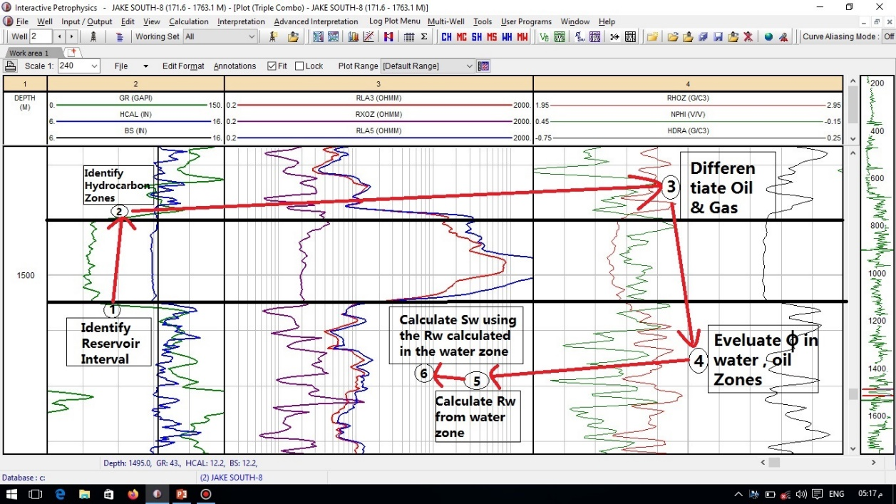
Introduction
Objectives
Methodology
Conclusion
P.statement
L.review
Results
References
Petrophysics parameters calculation using IP software
Notes:
Continue ????

Slide 15
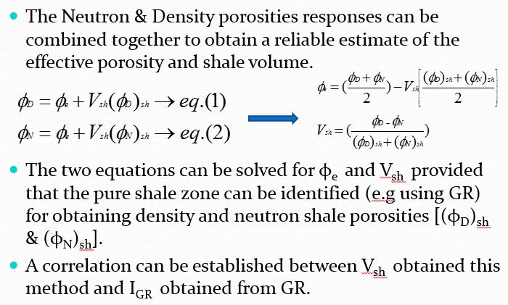
Introduction
Objectives
Methodology
Conclusion
P.statement
L.review
Results
References
SHALE VOLUME FROM GR LOG
NEUTRON-DENSITY COMBINA
Notes:
Continue ????

Slide 16
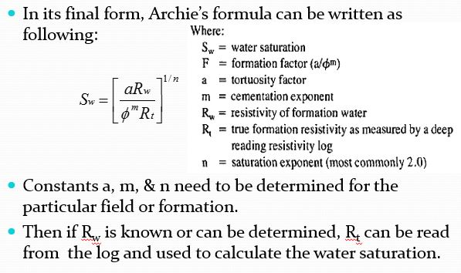
Introduction
Objectives
Methodology
Conclusion
P.statement
L.review
Results
References
Archie’s Equation
This equation is only valid for clean sandstone formations with uniform pore system.
Notes:
Continue ????

Slide 17

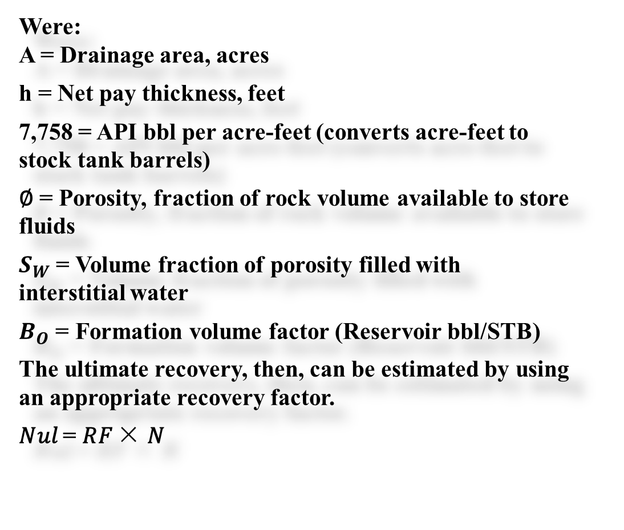
Introduction
Objectives
Methodology
Conclusion
P.statement
L.review
Results
References
Volumetric Method
Were:
A = Drainage area, acres
h = Net pay thickness, feet
7,758 = API bbl per acre-feet (converts acre-feet to stock tank barrels)
∅ = Porosity, fraction of rock volume available to store fluids
$S_{W}$ = Volume fraction of porosity filled with interstitial water
$B_{O}$ = Formation volume factor (Reservoir bbl/STB)
The ultimate recovery, then, can be estimated by using an appropriate recovery factor.
𝑁𝑢𝑙 = 𝑅𝐹 × 𝑁
Notes:
Continue ????

Slide 18
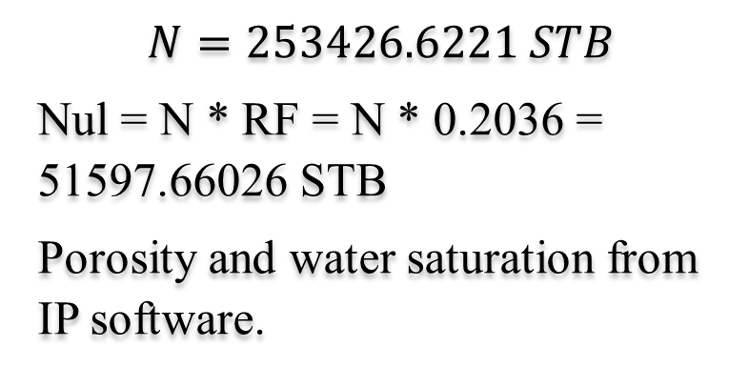
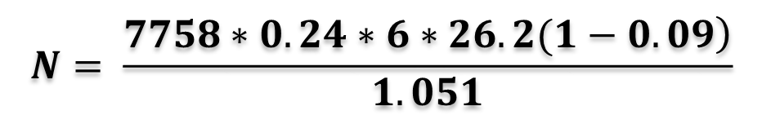
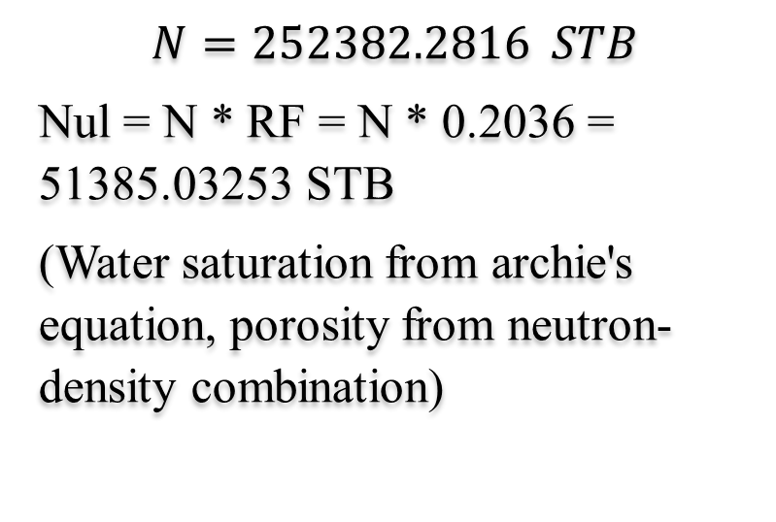
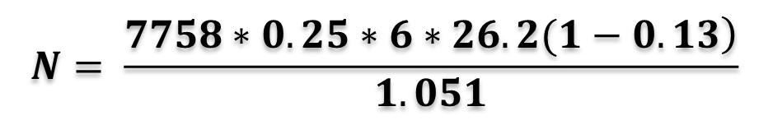
Introduction
Objectives
Methodology
Conclusion
P.statement
L.review
Results
References
Results
$$N= \frac{\left.7758∗0.24∗6∗26.2(1−0.09\right)}{1.051}$$
$$N= \frac{\left.7758∗0.25∗6∗26.2(1−0.13\right)}{1.051}$$
$$N=253426.6221 STB$$
Nul = N * RF = N * 0.2036 = 51597.66026 STB
Porosity and water saturation from IP software.
$$N=252382.2816 STB$$
Nul = N * RF = N * 0.2036 = 51385.03253 STB
(Water saturation from archie's equation, porosity from neutron-density combination)

Slide 19
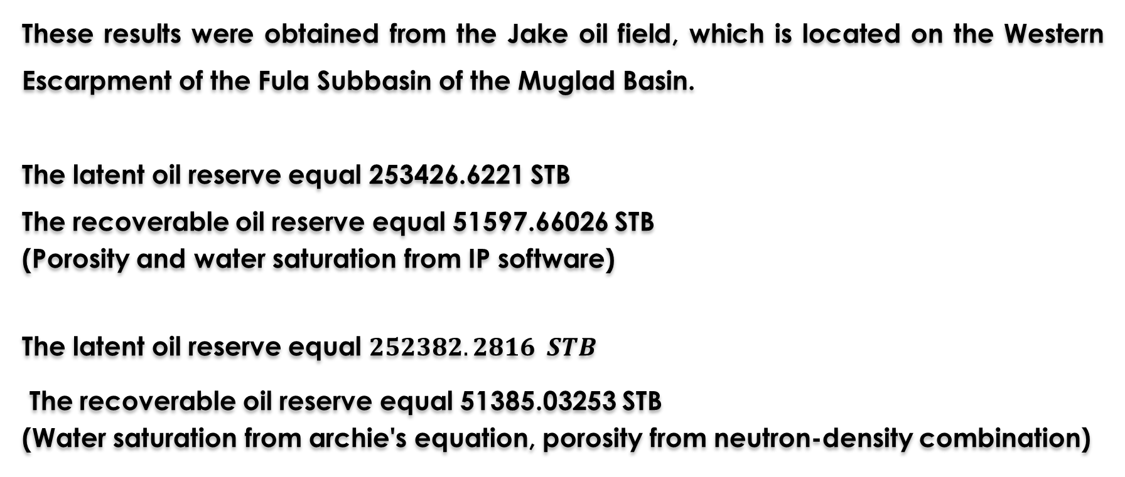
Introduction
Objectives
Methodology
Conclusion
P.statement
L.review
Results
References
Conclusions
These results were obtained from the Jake oil field, which is located on the Western Escarpment of the Fula Subbasin of the Muglad Basin.
The latent oil reserve equal 253426.6221 STB
The recoverable oil reserve equal 51597.66026 STB
(Porosity and water saturation from IP software)
The latent oil reserve equal $252382.2816 STB$
The recoverable oil reserve equal 51385.03253 STB
(Water saturation from archie's equation, porosity from neutron-density combination)

Slide 20
Introduction
Objectives
Methodology
Conclusion
P.statement
L.review
Results
References
Recommendations
We recommend to provide all information about this field, to get more accurate.
Dicline carve analysis one of the must approved way, so we recommend to use dicline carve analysis method, to get more accurate.
The IP program is effective and fast for a precise result of accounts in less time as possible.
The ArcMap program can be relied entirely in the area calculation.

Slide 21
Introduction
Objectives
Methodology
Conclusion
P.statement
L.review
Results
References
References Samples
Petroleum Geology And Resources Of The Sudan.
Us Energy Information Administration (2013).
Advanced Resources International (2005).
Well Testng Spe Text Book Serious Copy Right 1982 By Join Lee.
Reservior Eng.Handbook 3rd Eidition 2002 By Tarek Ahmad.

Slide 22
Literature Review
Introduction
Conclusion & Recommendations
Methodology
P. statement
References
RESULTS & Discussion
Objectives Of Project
Thanks

