Slide 1

بسم الله الرحمن الرحيم
Sudan University of Science and Technology College of Graduation Studies
A Thesis submitted in partial fulfillment of the requirements for the M.Sc. Degree in Biomedical Engineering
Diagnosis Of Diabetes Mellitus Using Artificial Neural Networks
Prepared by:
Samah mohammed elmustafa
Supervisors by :
Dr.Eltaher Mohamed Hussein
13 Augustus 2015

Slide 2
Outline
Introduction .
Literature review .
Problem statement .
Objectives .
Methodology .
Results .
Conclusion .
Recommendation .

Slide 3
Introduction :
Medical information systems in modern hospitals and medical institutions have become larger , Increased number of clinical databases, increases manual processing which increases the cost.
Most of the medical data sets are non-linear patterns and difficult to classify.
there is a need to enhance the classification by means of machine learning methods.

Slide 4
Introduction :
Artificial neural networks seemed to be one of the best approaches in machine learning methods.
The use of neural networks for diabetic Diagnosis has also attracted the interest of the medical informatics community because of their ability to model the nonlinear nature.
Back propagation algorithm is a classical domain dependent technique for supervised training.

Slide 5
Introduction :
Diabetes is disease
in which the body does not properly produce insulin. It is one of the most common chronic disease,
Type I diabetes, the disease is caused by the failure of pancreas, to produce sufficient insulin
type II the body is resistant to the insulin it makes, which leads to an uncontrolled increase of blood glucose unless the patient uses insulin or drug.

Slide 6
Literature Review
Application of a radial basis function neural network for diagnosis of diabetes mellitus , 10 NOVEMBER 2006, the results show in the Radial Basis Function (RBF) neural network performs better than other models
Predict the onset of diabetes disease using Artificial Neural Network (ANN) , April 2011, the model it can be a very good candidate for many real time domain applications as these are simple with good performances
On the Diagnosis of Diabetes Mellitus Using Artificial Neural Network Models , September 2011,
The GRNN/PNN network gave the best result out of the three architectures used. The other networks were unable to model the problem

Slide 7
Literature Review
Diagnosing diabetes using neural networks on small mobile devices , 2012 , This paper presents a novel approach for diagnosing diabetes using neural networks and pervasive healthcare computing technologies
Artificial neural networks in medical diagnosis , 7th January 2013, artificial intelligence methods (especially computer aided diagnosis and artificial neural networks) can be employed , These adaptive learning algorithms can handle diverse types of medical data and integrate them into categorized outputs.
Diagnosis of Diabetes Mellitus Type 2 , February 2014 , The proposed system can improve the strategy to a better level where artificial metaplasticity on perceptrons is implemented on neural network

Slide 8
Literature Review
Artifical Neural Networks To Detectect Risk Of Type 2 Diabetes , June, 2012 , In this research, 7 risk factors and their strength of association to the development of Type 2 diabetes was used as relative weight of input variables
Utilization of Neural Network for Disease Forecasting , This paper will present the use of neural network to learn the historical patterns of disease incidence to forecast future incidence .
Fuzzy based modeling for diabetic diagnostic decision support using Artificial Neural Network , April 2011 , proposed algorithm to optimally model the diagnostic process for small or large datasets; especially, due to its computational simplicity.

Slide 9
The problem statement
Increased number of diabetic clinical databases, increases traditional manual data analysis and processing has become inefficient ,which increases the cost.
The diabetic data sets are non-linear patterns and difficult to classify and diagnosis

Slide 10
Objective
The goal of this study is to propose the use of Artificial neural networks (ANNs) for efficient computer-based analysis are essential for diagnosing of Diabetes Mellitus because provides an improvement in accuracy, sensitivity, and specificity in comparison with other methods there manual data analysis of the diabetes mullitus has become inefficient.

Slide 11
Methodology
One of important gols Artificial Neural Networks (ANNs) is processing information
design and train of neural network make it qualified for decision maker operation when it faced new data outside training data ; this well provide ANNs high reliability exactly like experiment humans.

Slide 12
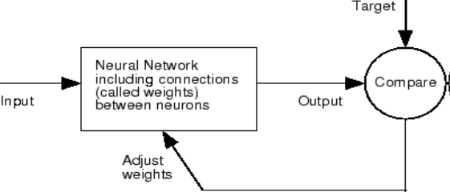
Methodology
The ANs in the network can be trained by adjusting the values of the connections (weights) between elements. to get the final weights for a particular function that make the output of the neural match the target

Slide 13
Methodology
In this study, three-layered Multilayer Perceptron (MLP) in the three network :
feed-forward neural network architecture.
Elman network architecture.
Recurrent network architecture .
The backpropagation training algorithm is an iterative gradient algorithm designed to minimize the mean square error between the actual output to a multi-layer feed-forward, Elman , Recurrent perceptron and the desired output.

Slide 14
feed-forward neural network
a particular case of training data is fed through the network in a forward direction, producing results at the output layer error is calculated at output nodes based on known target information , and the necessary changes to the weights that lead into the output layer are determined based upon this error calculation
weight changes are calculated , layer by layer , as a function of the errors determined for all subsequent layers , working backward toward the input layer

Slide 15
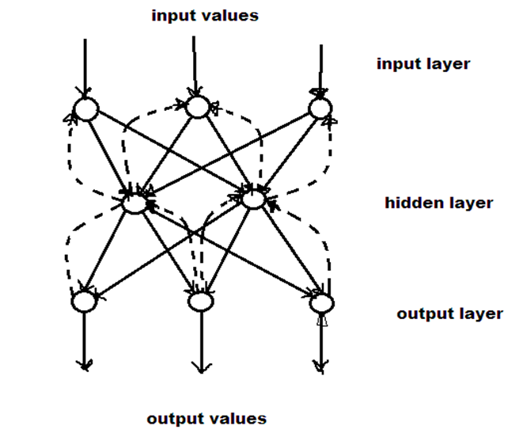
feed-forward neural network

Slide 16
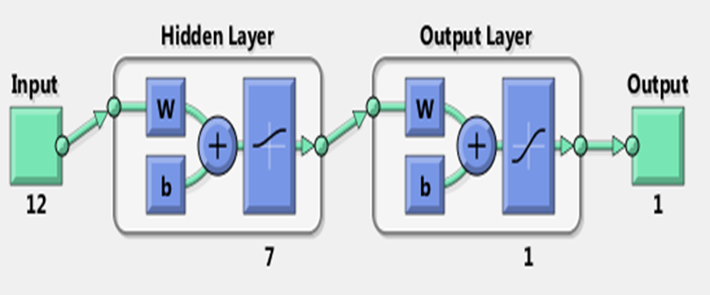
feed-forward neural network

Slide 17
Recurrent neural network
Layer recurrent network are similar to feed_forward networks , except that each layer has a recurrent connection with a tap delay associated with it
the context units remember the previous internal state . thus, the hidden units have the task of mapping both an external input , and also the previous internal state of some desired output.

Slide 18
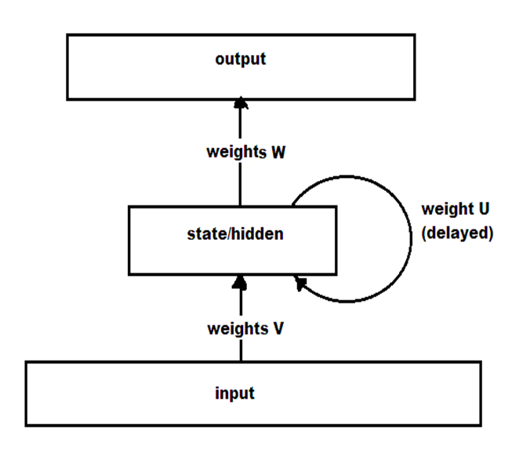
Recurrent neural network

Slide 19
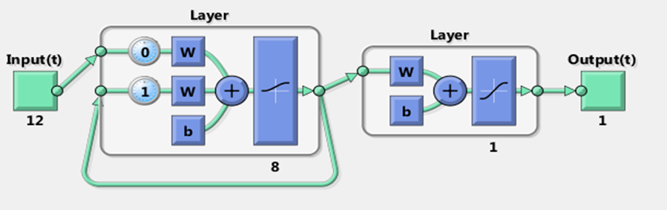
Recurrent neural network

Slide 20
Elman Network
there are connections from the hidden layer to these context units fixed with a weight of one
the input is propagated in a standard feed forward fashion , and then a simple back prop-like learning rule is applied
The fixed back connections result in the context units always maintaining a copy of the previous value of hidden units

Slide 21
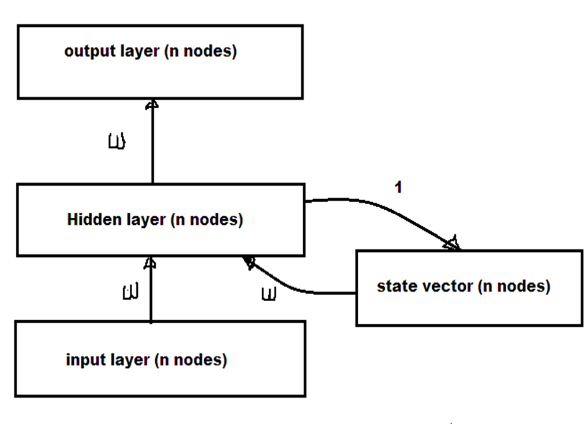
Elman Network

Slide 22
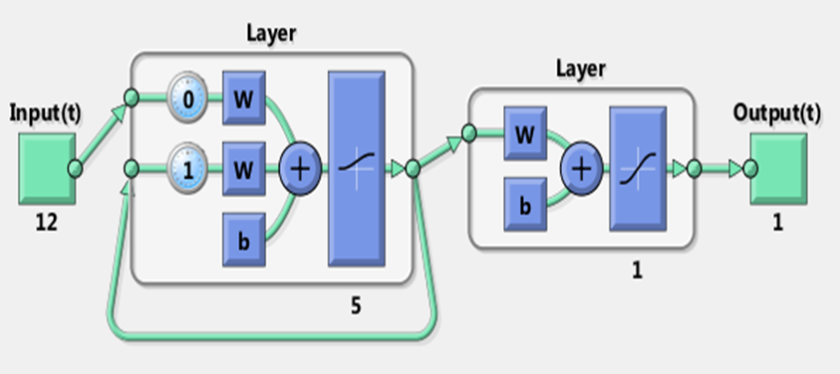
Elman Network

Slide 23
Data set
age
sex
physical activity
pregnancy
diabetes in the family
body mass index( weight )
body mass index( height )
diastolic blood pressure
systolic blood pressure
pedigree of diabetes
urine sugar

Slide 24
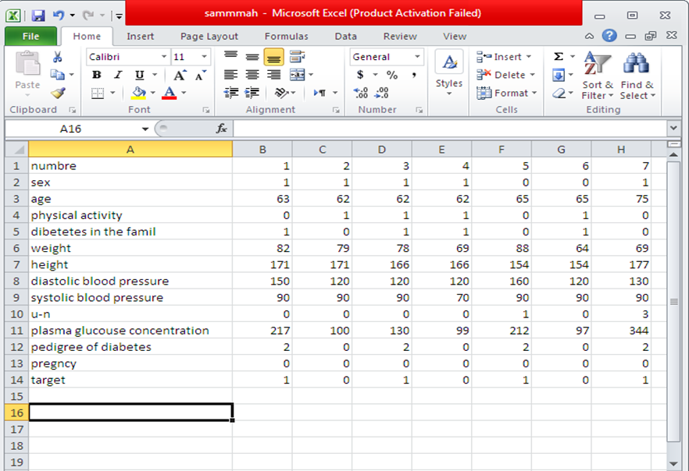
Data set

Slide 25
Methodology
Using nntool in MATLAB in comment windows was designed and trained ,first one hidden layer between input and output layer with 3,4,5,6,7,8,9 neuron in hidden layer . type of activation function which chooses firstly is log sigmoid, Then for the same network, activation function was replaced first by tan sigmoid function.
This step usining in three networks.

Slide 26
Performance of validation
The property training record best_epoch indicates the iteration at which the validation performance reached a minimum.
The validating the network is to create a regression plot, which shows the relationship between the outputs of the network and the targets

Slide 27
The Results

Slide 28
the results obtained in the study
The result obtained that amount the three neural network.
1- the elman network with 5 neuron in the hidden layer with TAN sigmoid activation function has performance 0.00083289
2- For the BPNN with 7 neuron in the hidden layer with tan sigmoid activation function has performance 0.00011178
3- For the RNN with 8 neuron in the hidden layer with LOG sigmoid activation function has performance 0.00019097.

Slide 29
This table shown in The result obtained that amount the three neural network
 | BPNN | RNN | ELMAN
Best of Performance | 0.00011178 | 0.00019097 | 0.00083289
Number of neuron in hidden layer | 7 | 8 | 5
Activation function | TAN | LOG | TAN

Slide 30
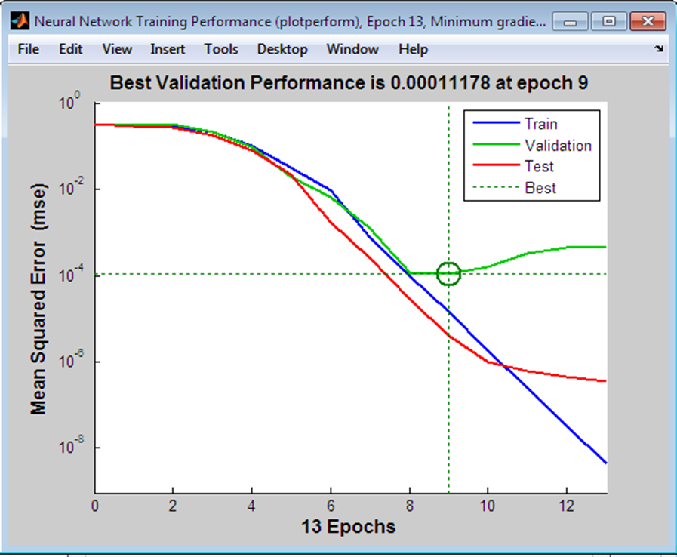
training result for BP NN with 5 neuron and TAN sigmoid activation function

Slide 31
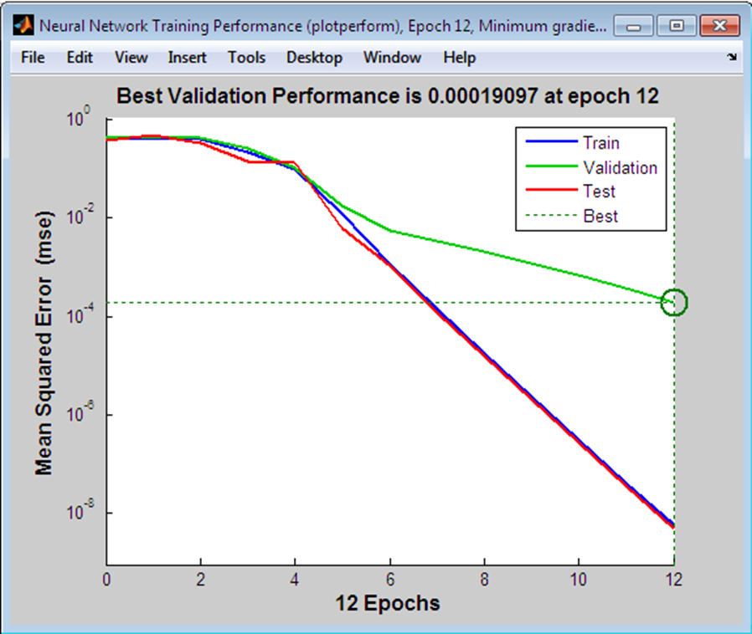
training result for RNN with 8 neuron and LOG sigmoid activation function

Slide 32
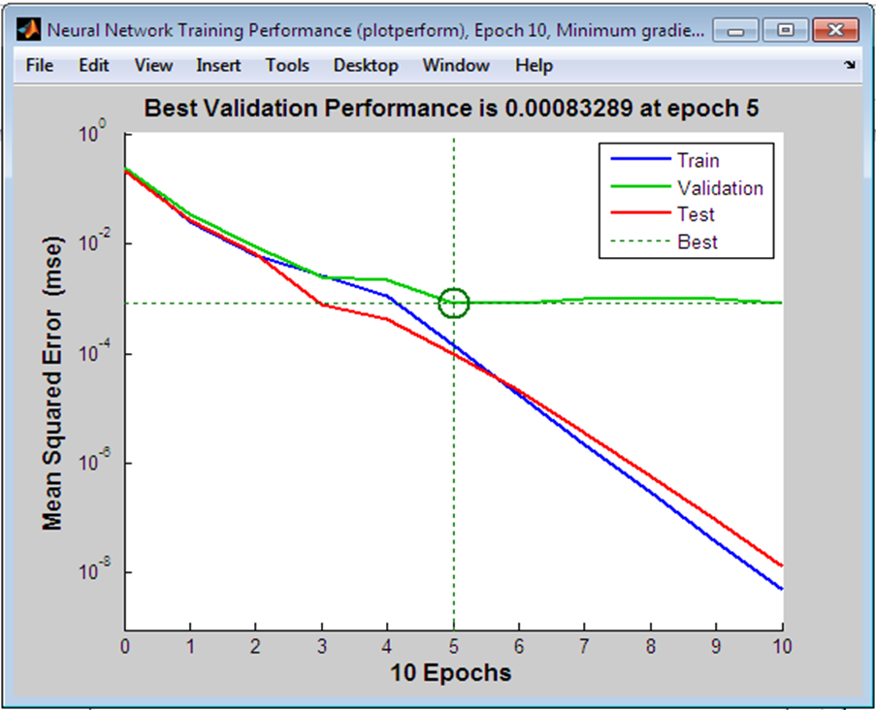
training result for elman with 5 neuron and TAN sigmoid activation function

Slide 33
1 Conclusion
The goal of this study is to Design a novel approach for diagnosing Diabetes using Artificial neural networks. The study aims also identify the best ANNs type which is more suitable for Diagnoses Diabetes . so three ANNs was designed which are feed forward back propagation ,Recurrent and Elman network to designed which one has the best performance .
The result obtained that amount the three neural network.
1- the elman network with 5 neuron in the hidden layer with TAN sigmoid activation function has performance 0.00083289 2- For the BPNN with 7 neuron in the hidden layer with TAN sigmoid activation function has performance 0.00011178 that is best performance network in this studay. 3- For the RNN with 8 neuron in the hidden layer with LOG sigmoid activation function has performance 0.00019097.

Slide 34
Recommendation
The recummention of this work are :
1- Competition neurofuzzy will be recommended
2- The receiving of the aspirations of this work linked to telemedicine or other communication techniques.
3- after the relative success in the diagnosis of diabetes and early detection to him, according to his competence by high it is recommending its use as a system are reliable in all health facilities, center professional diagnosis of diabetes in sudan

Slide 35
References
[1] - Og˘uz Karan .Canan Bayraktar .Haluk Gümüs kaya .Bekir Karlık .Diagnosing diabetes using neural networks on small mobile devices , 2011.
[2] - Filippo Amato. Alberto López. Eladia María Peña-Méndez. Petr Vaňhara. Aleš Hampl. Josef Havel .Artificial neural networks in medical diagnosis. Received 17th December 2012. Published online 7th January 2013.
[3] - A. B. Adeyemo. A. E. Akinwonmi. On the Diagnosis of Diabetes Mellitus Using Artificial Neural Network Models. African Journal of Computing & ICT September 2011.
[4] - Manaswini Pradhan. Dr. Ranjit Kumar Sahu. Predict the onset of diabetes disease using Artificial Neural Network (ANN). International Journal of Computer Science & Emerging Technologies (E-ISSN: 2044-6004) 303 Volume 2, Issue 2, April 2011.
[5] - P. Venkatesan and S. Anitha Application of a radial basis function neural network for diagnosis of diabetes mellitus , CURRENT SCIENCE, VOL. 91, NO. 9, 10 NOVEMBER 2006.
[6] - Poonguzhali.E, Sabarmathi Kabilan, Sandia Kannan, Sivagami.P . Diagnosis of Diabetes Mellitus Type 2 . International Journal of Emerging Technology and Advanced Engineering. Volume 4, Issue 2, February 2014.
[7] - B. Y. Baha , Bank, Yola , and G. M. Wajiga , Artifical Neural Networks To Detectect Risk Of Type 2 Diabetes , June, 2012.
[8] - O. Wahyunggoro, A.E. Permanasari, and A. Chamsudin, Utilization of Neural Network for Disease Forecasting ,2012.
[9] - – K. Rajeswari , V. Vaithiyanathan , Fuzzy based modeling for diabetic diagnostic decision support using Artificial Neural Network , April 2011.
[10] – H. Demuth, M. Beale, M Hagan ,Neural Network Toolbox™ 6 ,2009

Slide 36

Thank you

